Slide 1
SLOVENIA

Slide 2
SLOVENIA
Country in the Balkans
Slovenia, a country in Central Europe, is known for its mountains, ski resorts and lakes. On Lake Bled, a glacial lake fed by hot springs, the town of Bled contains a church-topped islet and a cliffside medieval castle. In Ljubljana, Slovenia’s capital, baroque facades mix with the 20th-century architecture of native Jože Plečnik, whose iconic Tromostovje (Triple Bridge) spans the tightly curving Ljubljanica River.

Slide 3
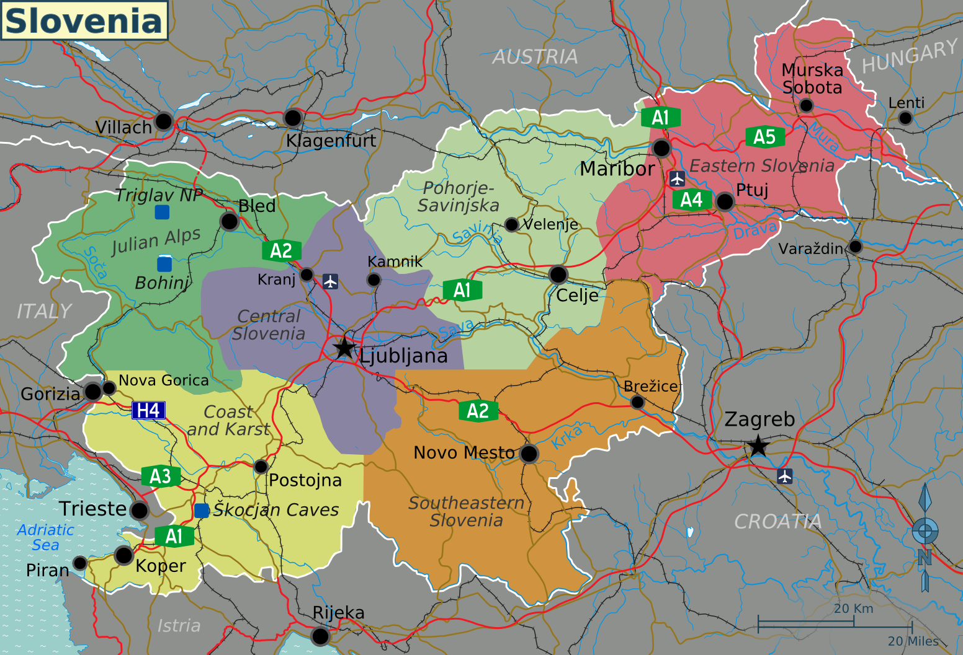

Slide 4
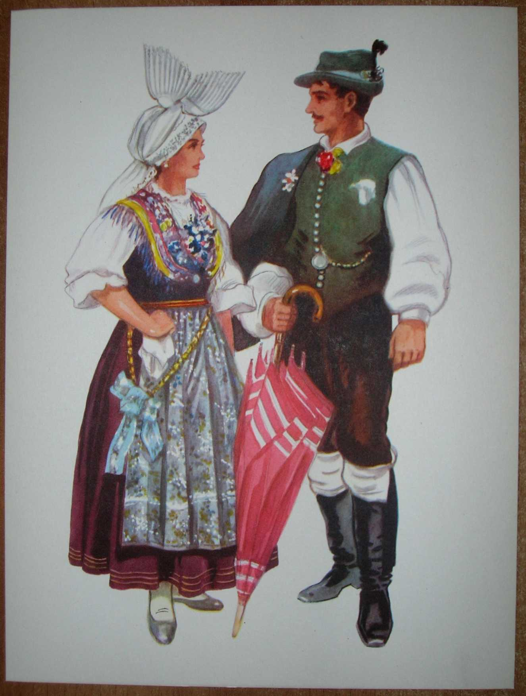
Trajes folkloricos tradicionales

Slide 5
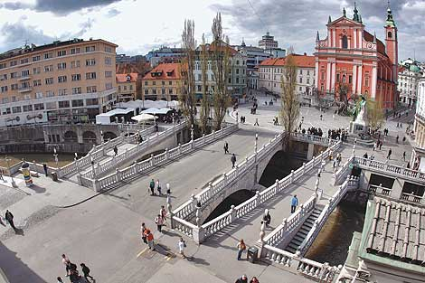
Ljubljana Triple Bridge

Slide 6
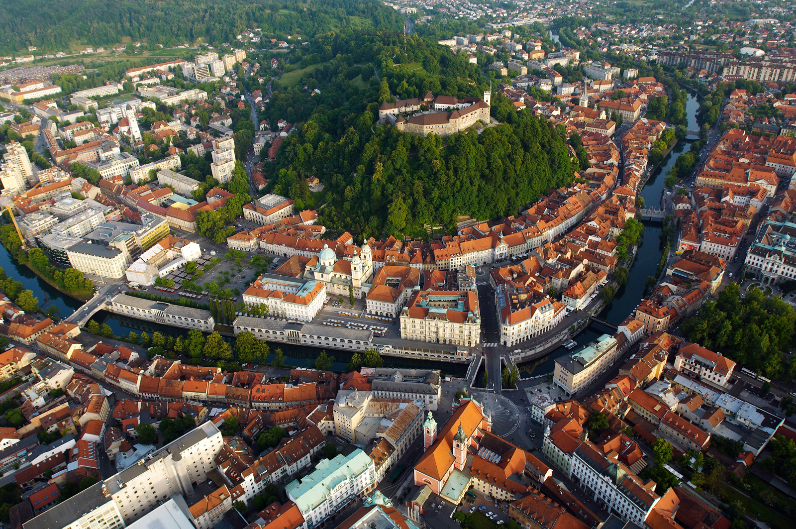
Ljubjana

Slide 7
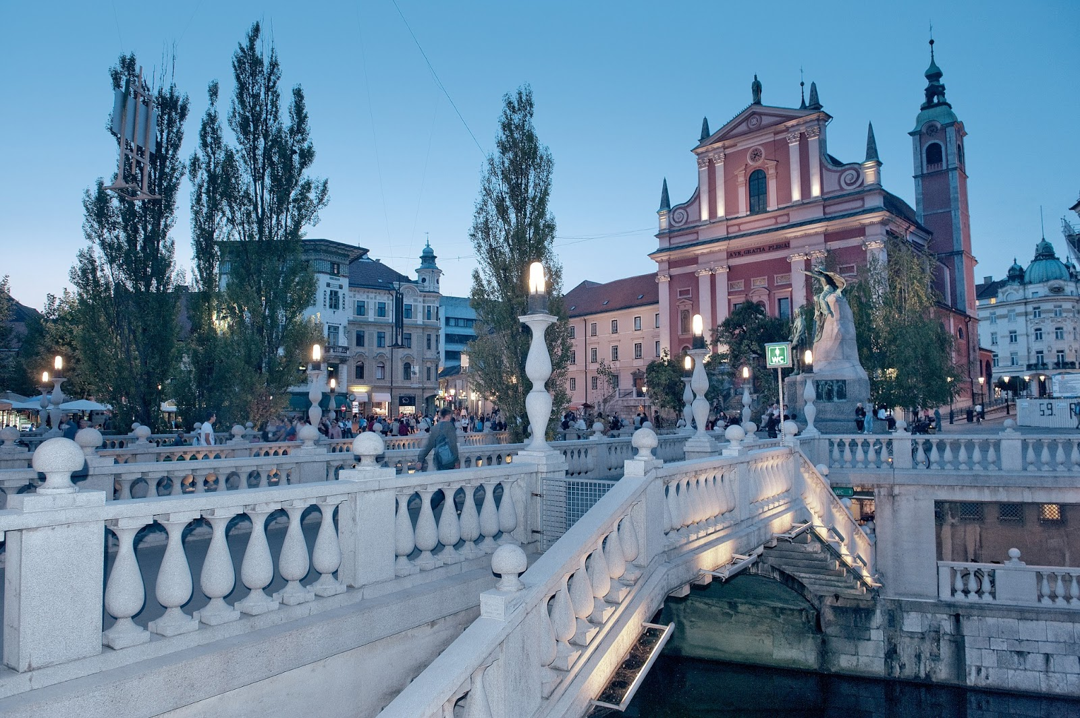

Slide 8
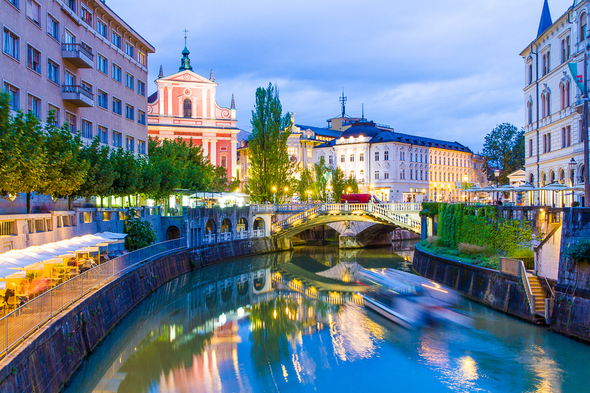

Slide 9
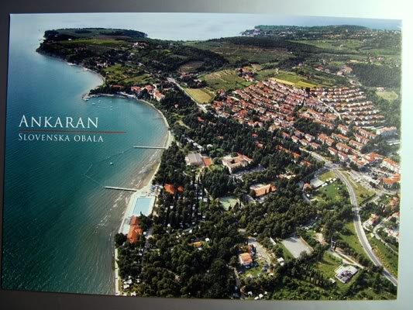

Slide 10
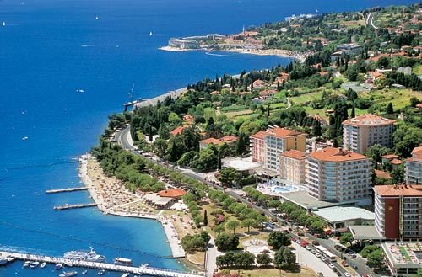

Slide 11
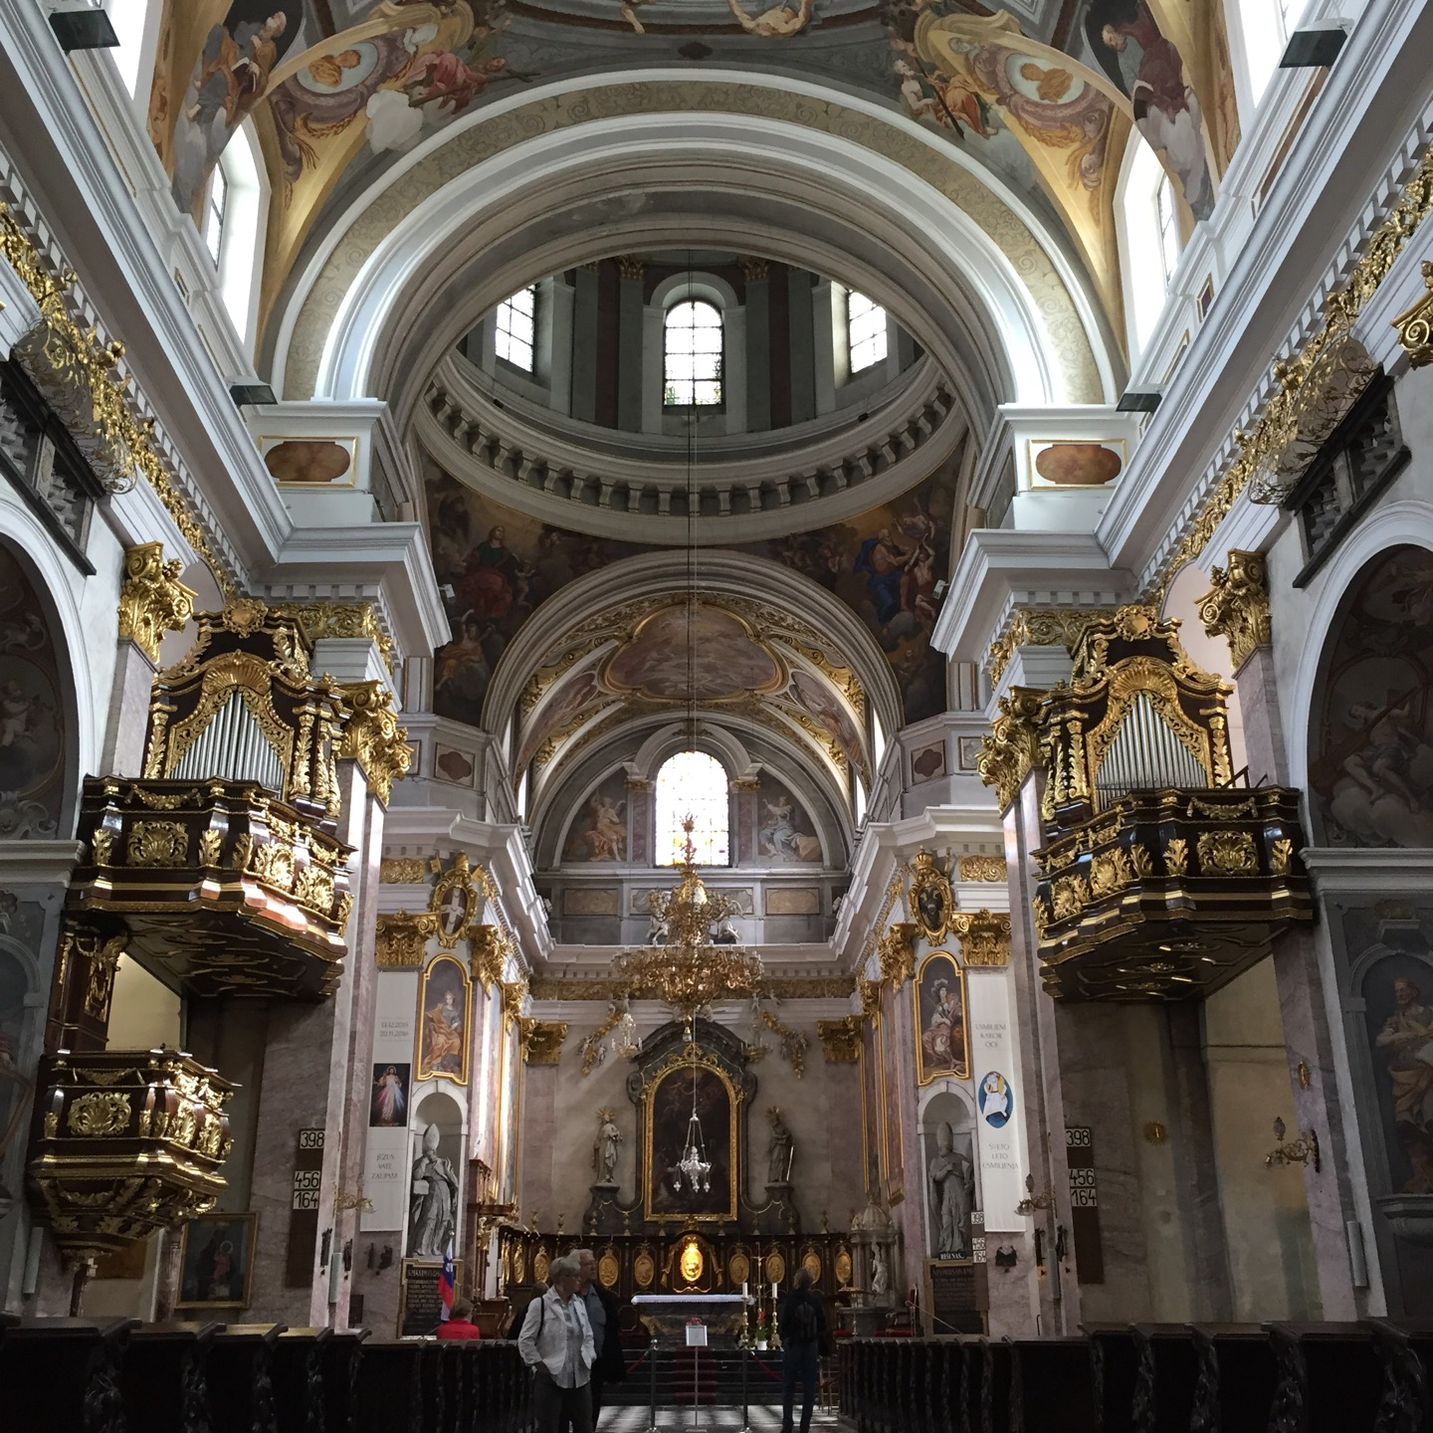

Slide 12
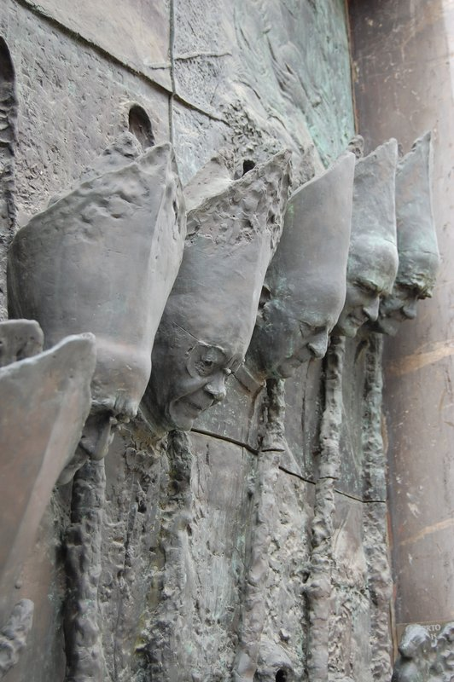

Slide 13
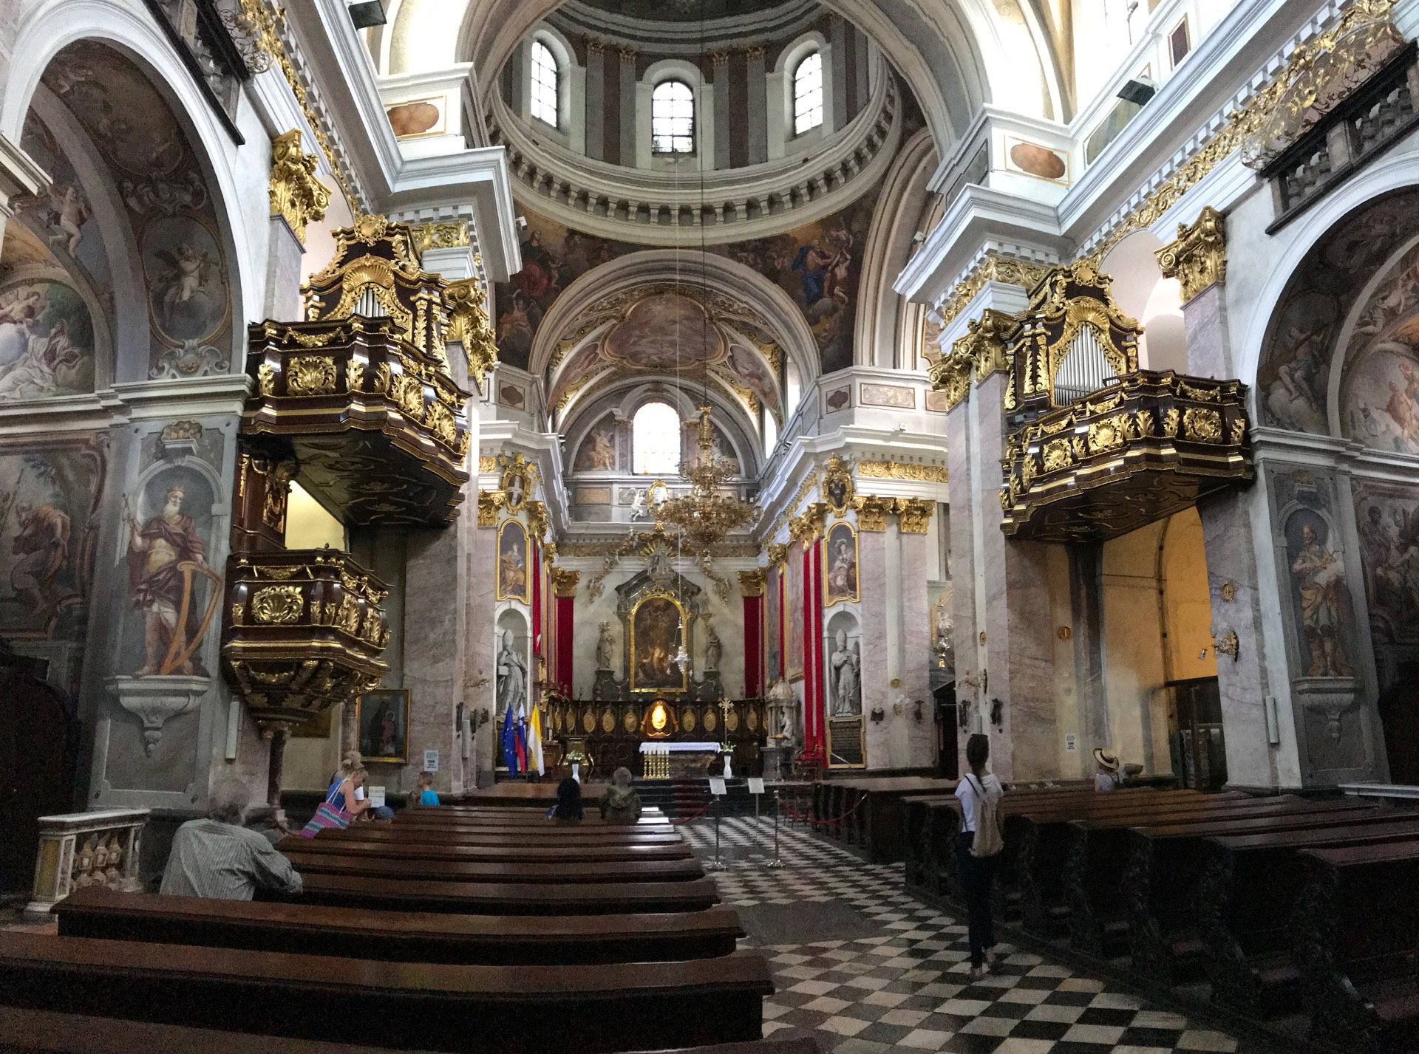

Slide 14
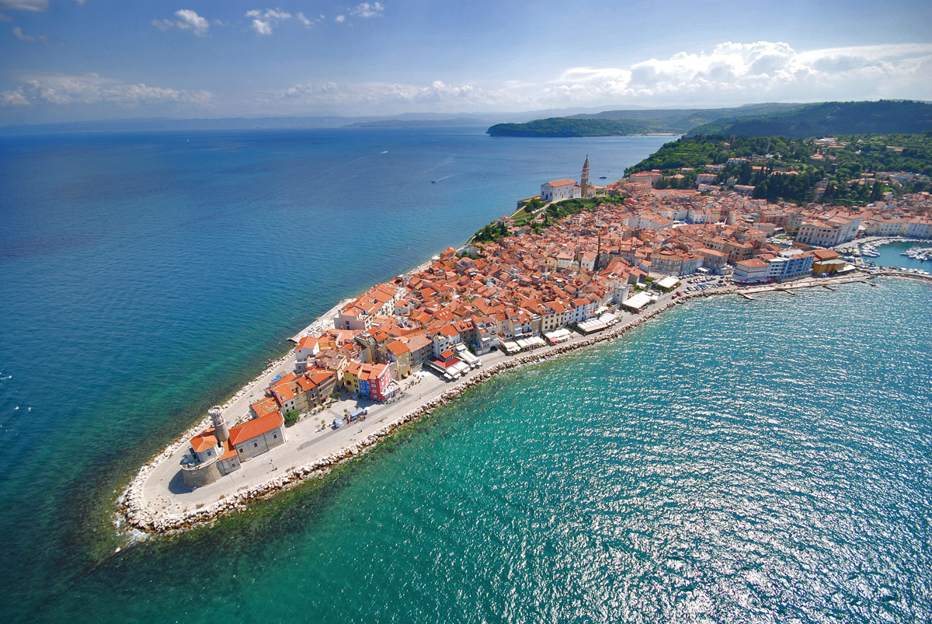
Izola Slovenia

Slide 15
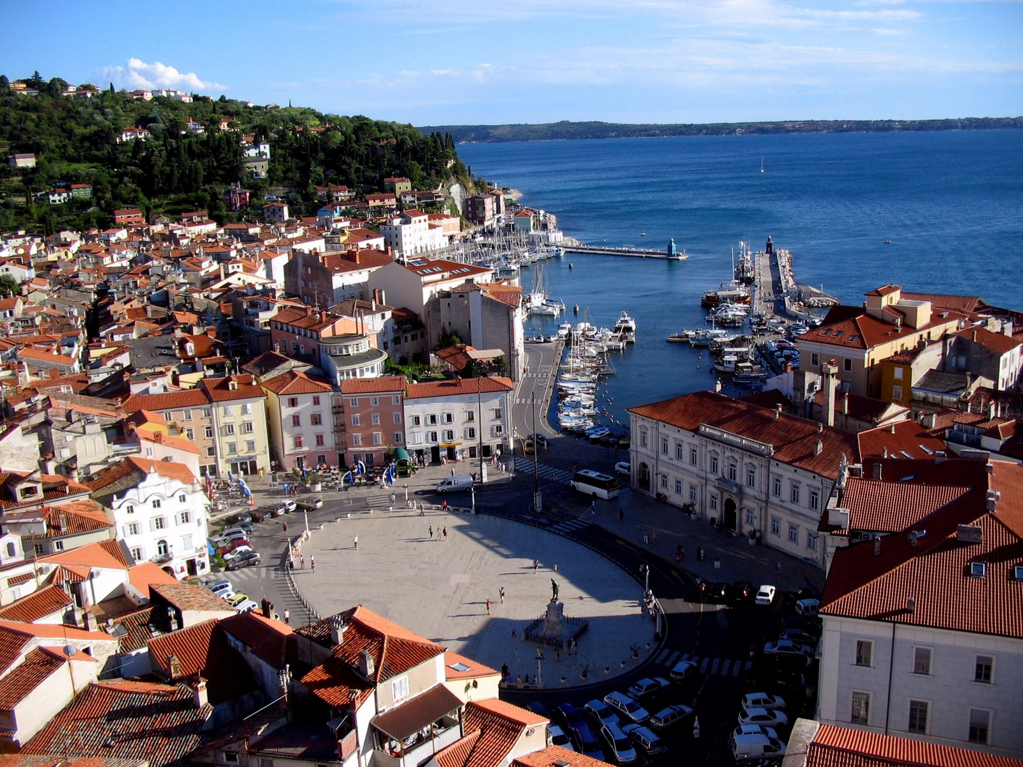
KOPER

Slide 16
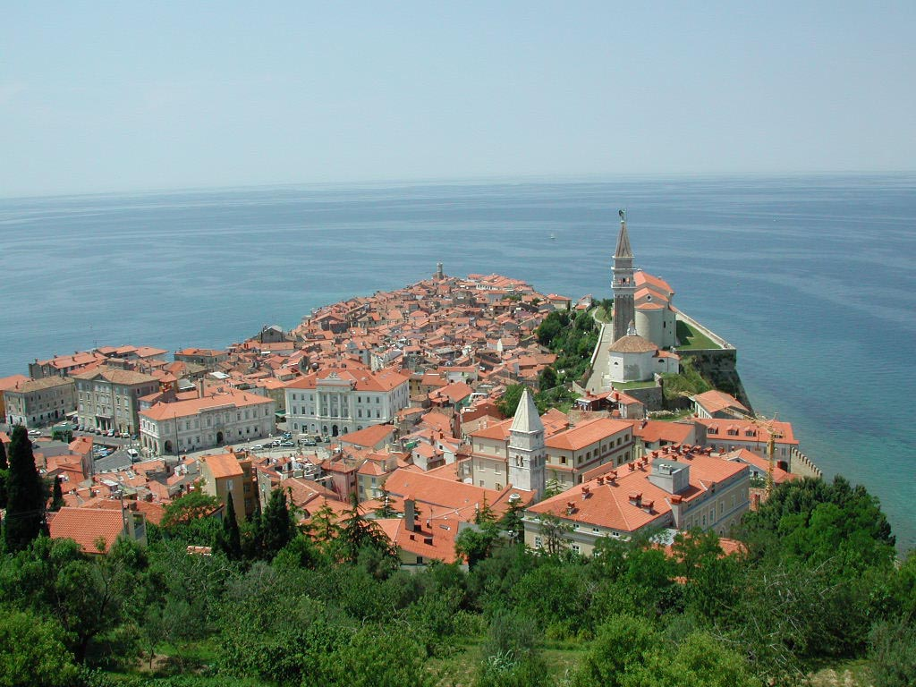
KOPER

Slide 17
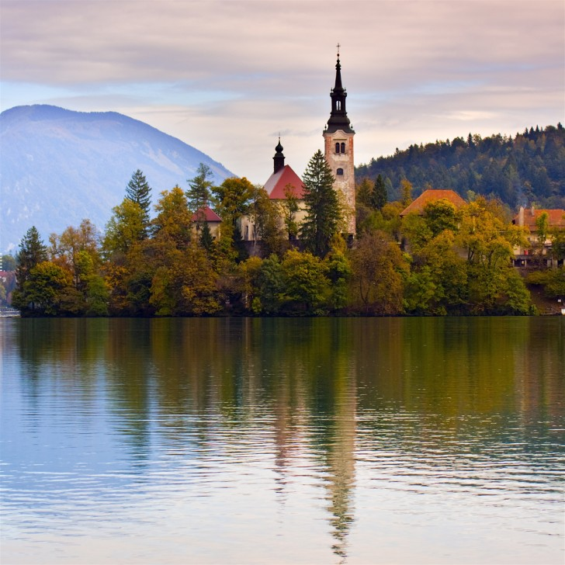
LAKE BLED

Slide 18
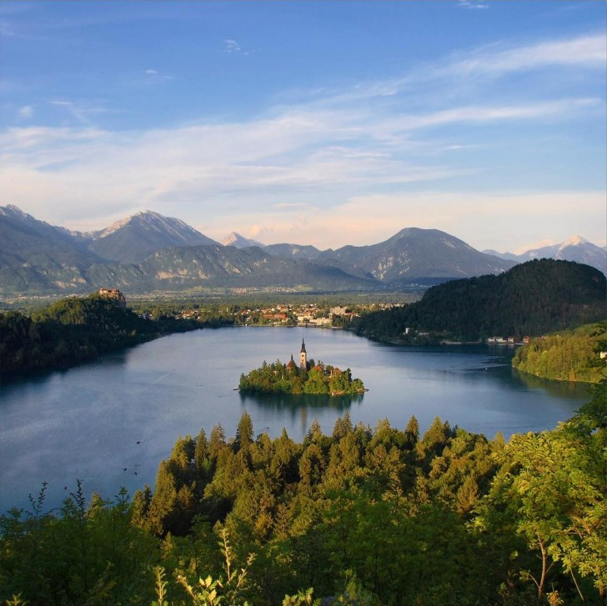

Slide 19
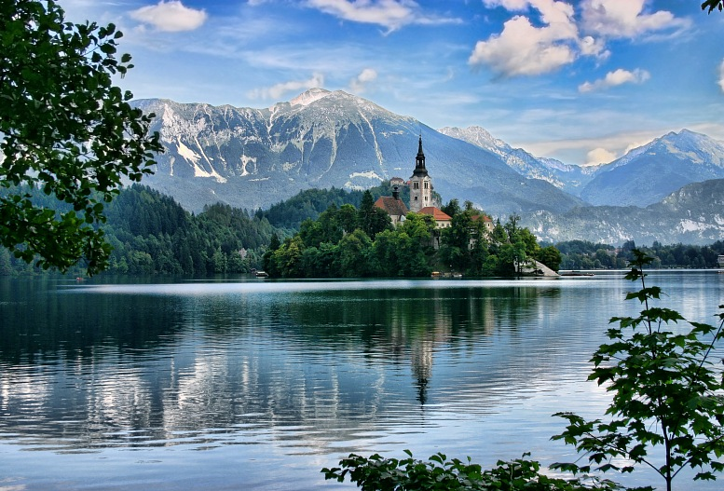

Slide 20
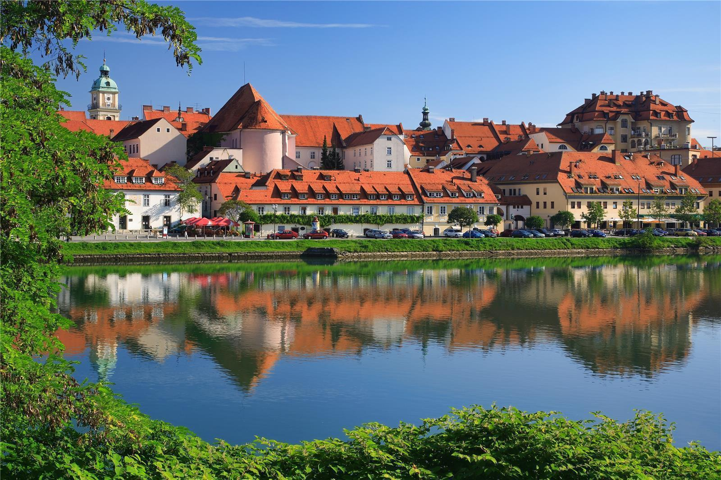
MARIBOR

Slide 21
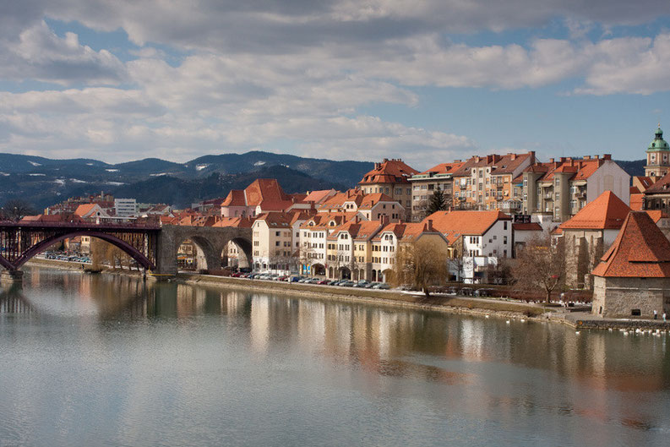
MARIBOR

Slide 22
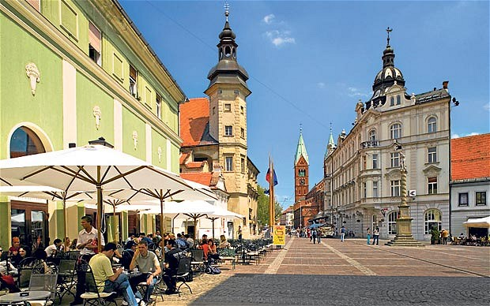
MARIBOR

Slide 23
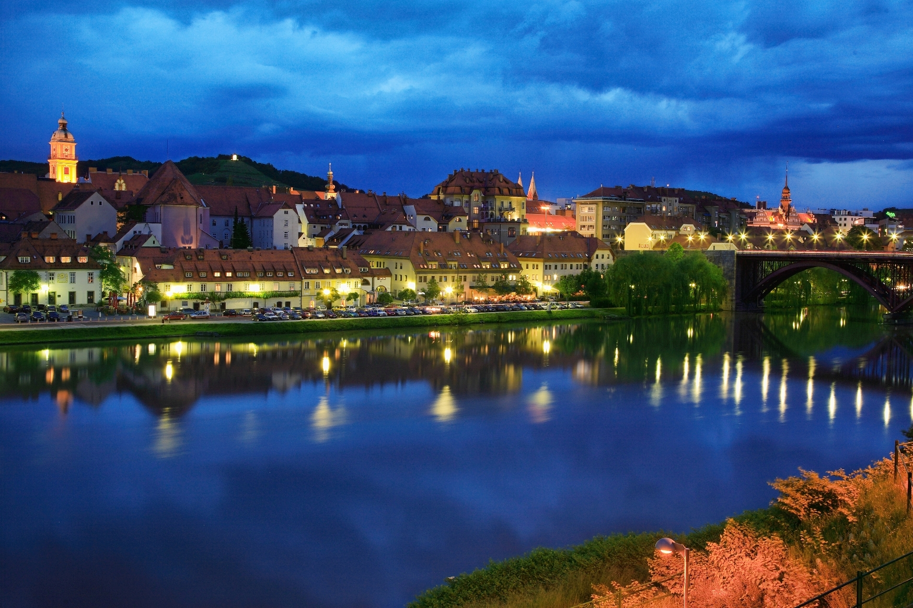
MARIBOR

Slide 24
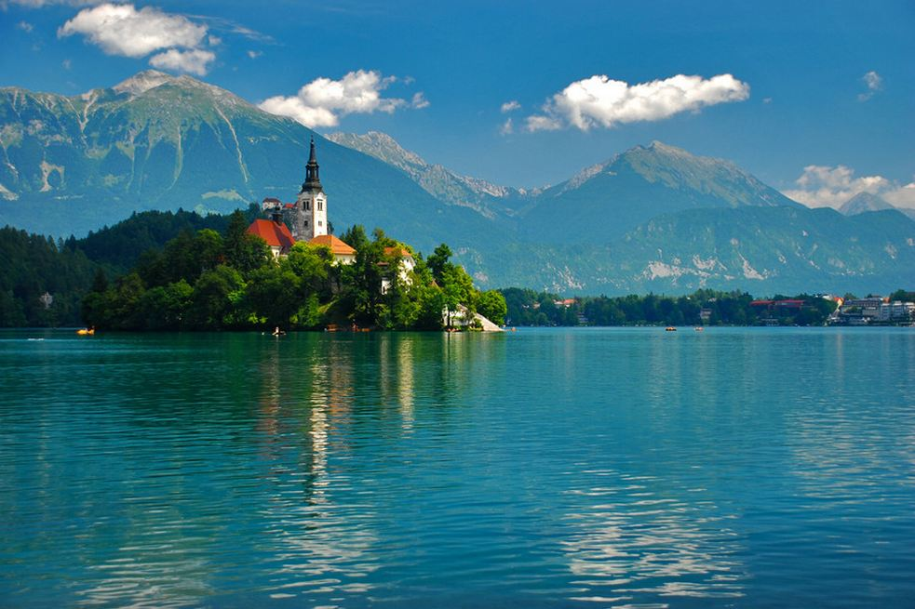
PAULO SANTOS

Slide 25
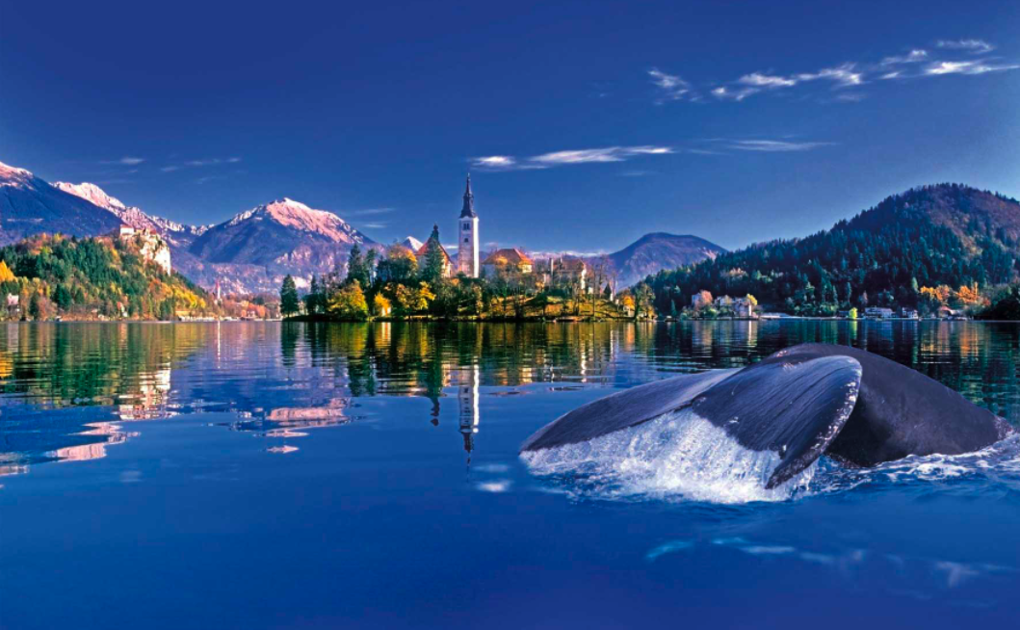
LAKE BLED

Slide 26
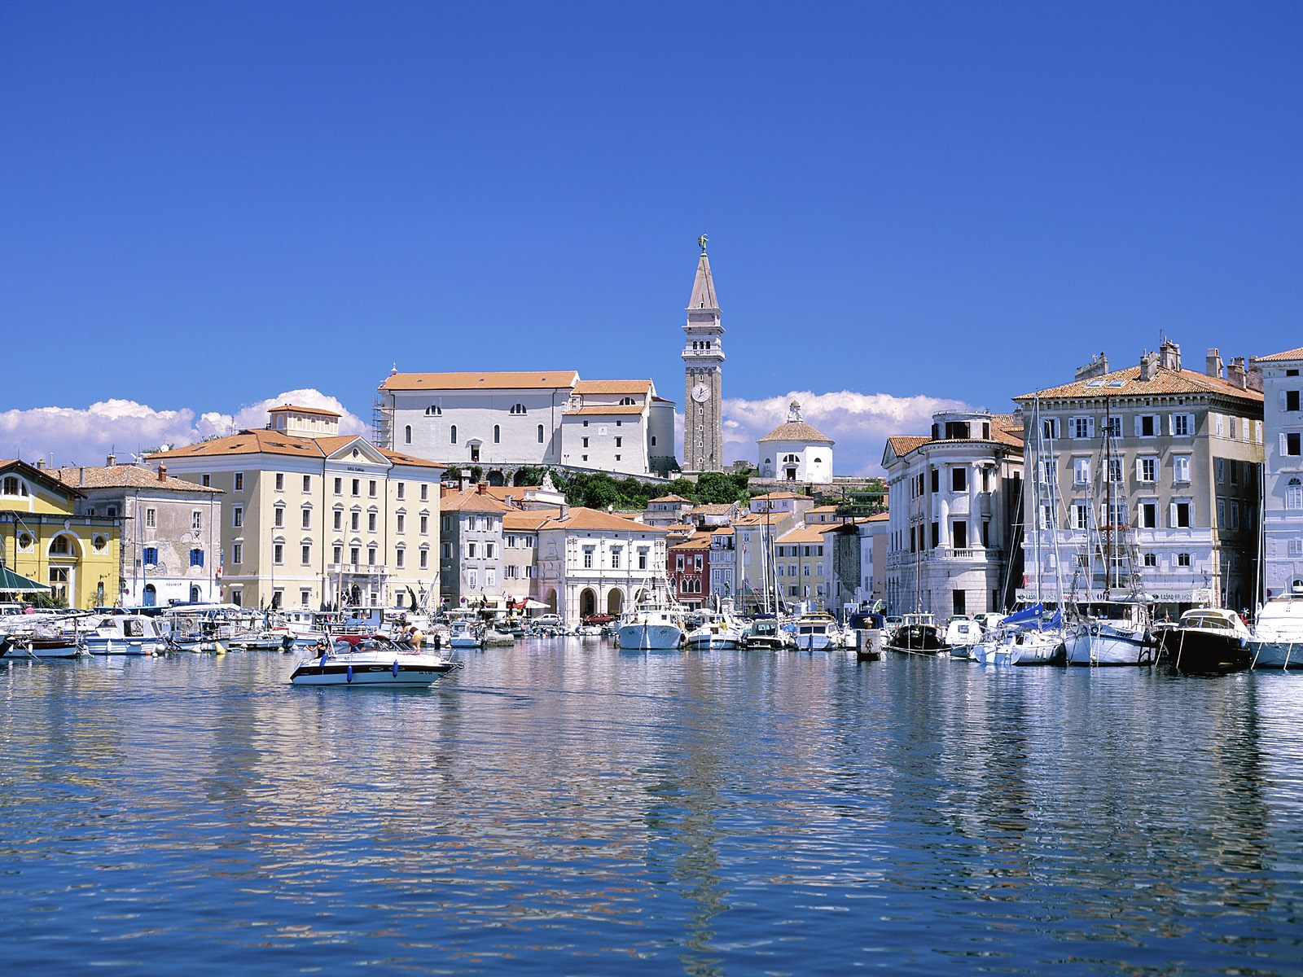
PIRAN

Slide 27
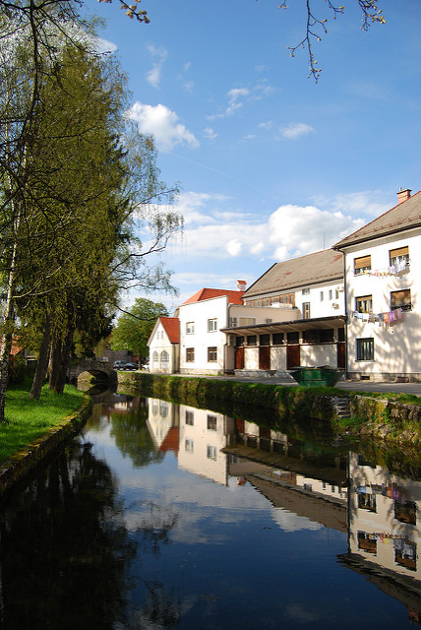
RIBNICA

Slide 28
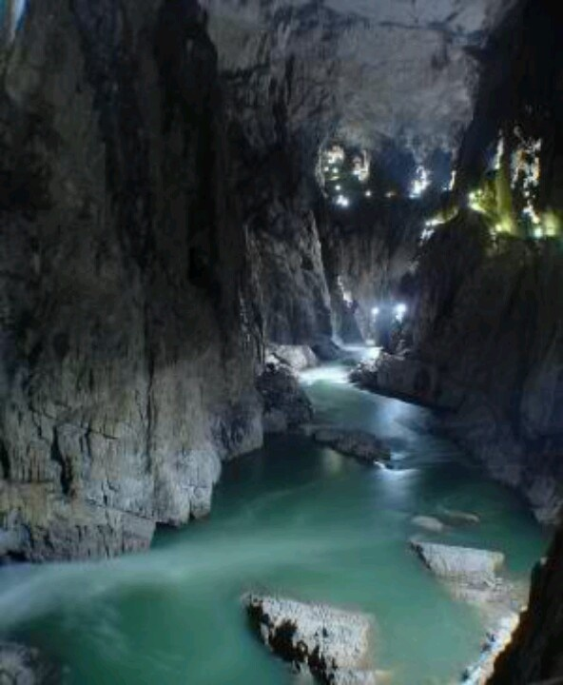
Skocjan Caves

Slide 29
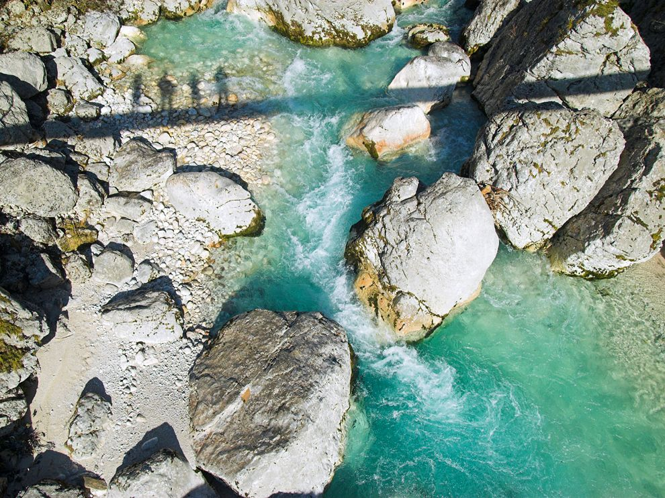
SOKA RIVER

Slide 30
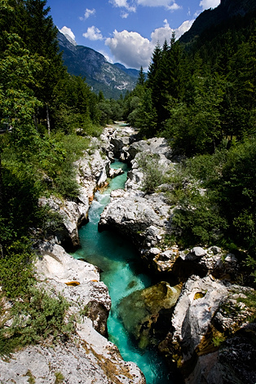
SOKA RIVER

Slide 31
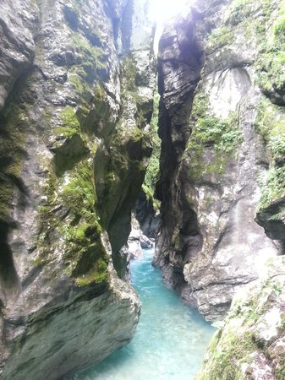
TOMLIN GORGES

Slide 32
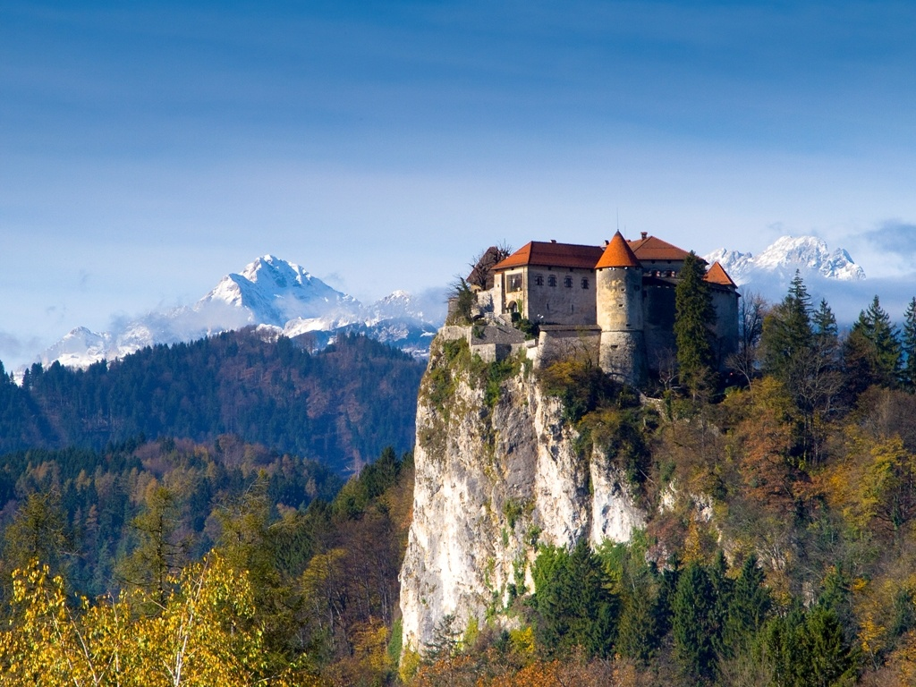
KLEME

Slide 33
FIN

